Slide 1
Spectra of the Moon using a Robotic Telescope
E.Almas, T.Christoffersen, W.Hogg, E.Stone

Slide 2
Goals: the following steps (1-5) are mandatory in order to complete the project, however you may boost marks, either as a group, or as an individual, with optional goals (5-8).
(1)Demonstrate acquiring calibrated test spectra of different materials .g. tarmac, concrete, rock samples, vegetation, using a hand held spectrometer.
(2)Use N (e.g. 20) identifiable reference areas of the Moon (highland and/or mare) to calibrate measured brightness values in the CCD camera wrt a standard lunar pectrum(find this on-line).
(3)select and measure some target areas that you want to measure the spectrum of wrt the previously derived standard lunar spectra.
(4)Analyse the spectra from (3) to determine –can you see any mineral absorption ands –what might these be? What is/are the most colourful area(s)f the Moon?
(5)How accurately can you measure absorption bands in the spectra of lunar surface features you are studying(use propagation of errors)?
(6)Investigate whether the telescope optics suffer from vignetting, or other non-linear sensitivity effects, across the image. Can you calibrate out/mitigate this effect if present?
(7)Experiment with producing meaningful co-registered colour ratio images of the lunar surface o highlight surface composition differences.
(8)Repeat your spectra measurements at other lunar phases to see if the surface changes colour at different illumination and viewing angles?

Slide 3
Spectra of objects with handheld spectrometer

Slide 4
Calibrating the Spectrometer
“Before analysing a sample it is frequently necessary to check the calibration of the spectrometer that is being used. This is performed by analysing known samples and measuring the error between the empirical and known values for the samples. A skew, or bias, can be introduced into the data handling routines of the data analysis equipment of the spectrometer to compensate for these differences.”
Davies, Anthony MC, and Harald A. Martens. "Method and apparatus for calibrating a spectrometer." U.S. Patent No. 5,321,970. 21 Jun. 1994.

Slide 5
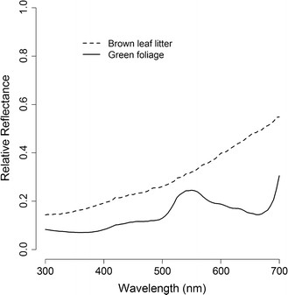
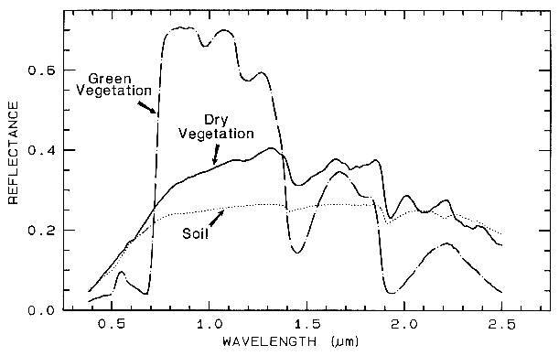
Comparing to Known spectra
Figure 1: Mean reflectance spectra of brown leaf litter (n = 20) and... - Scientific Figure on ResearchGate. Available from: https://www.researchgate.net/figure/276212092_fig6_Figure-1-Mean-reflectance-spectra-of-brown-leaf-litter-n-20-and-green-foliage-n [accessed Feb 19, 2016]
Only leaf has a good spectrum for comparison
(other materials are too generic to find data for)
http://speclab.cr.usgs.gov/PAPERS.refl-mrs/refl4.html#section4.3

Slide 6
Comparing to Known spectra
Figure 1: Mean reflectance spectra of brown leaf litter (n = 20) and... - Scientific Figure on ResearchGate. Available from: https://www.researchgate.net/figure/276212092_fig6_Figure-1-Mean-reflectance-spectra-of-brown-leaf-litter-n-20-and-green-foliage-n [accessed Feb 19, 2016]
Couldn’t find data values, and can’t read from these graphs, so calibrating our data wasn’t possible here
http://speclab.cr.usgs.gov/PAPERS.refl-mrs/refl4.html#section4.3

Slide 7
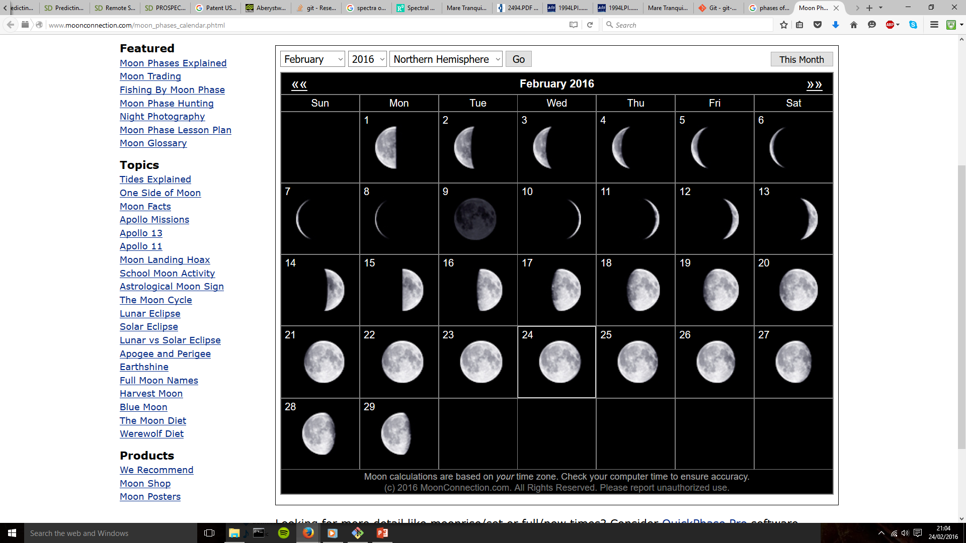
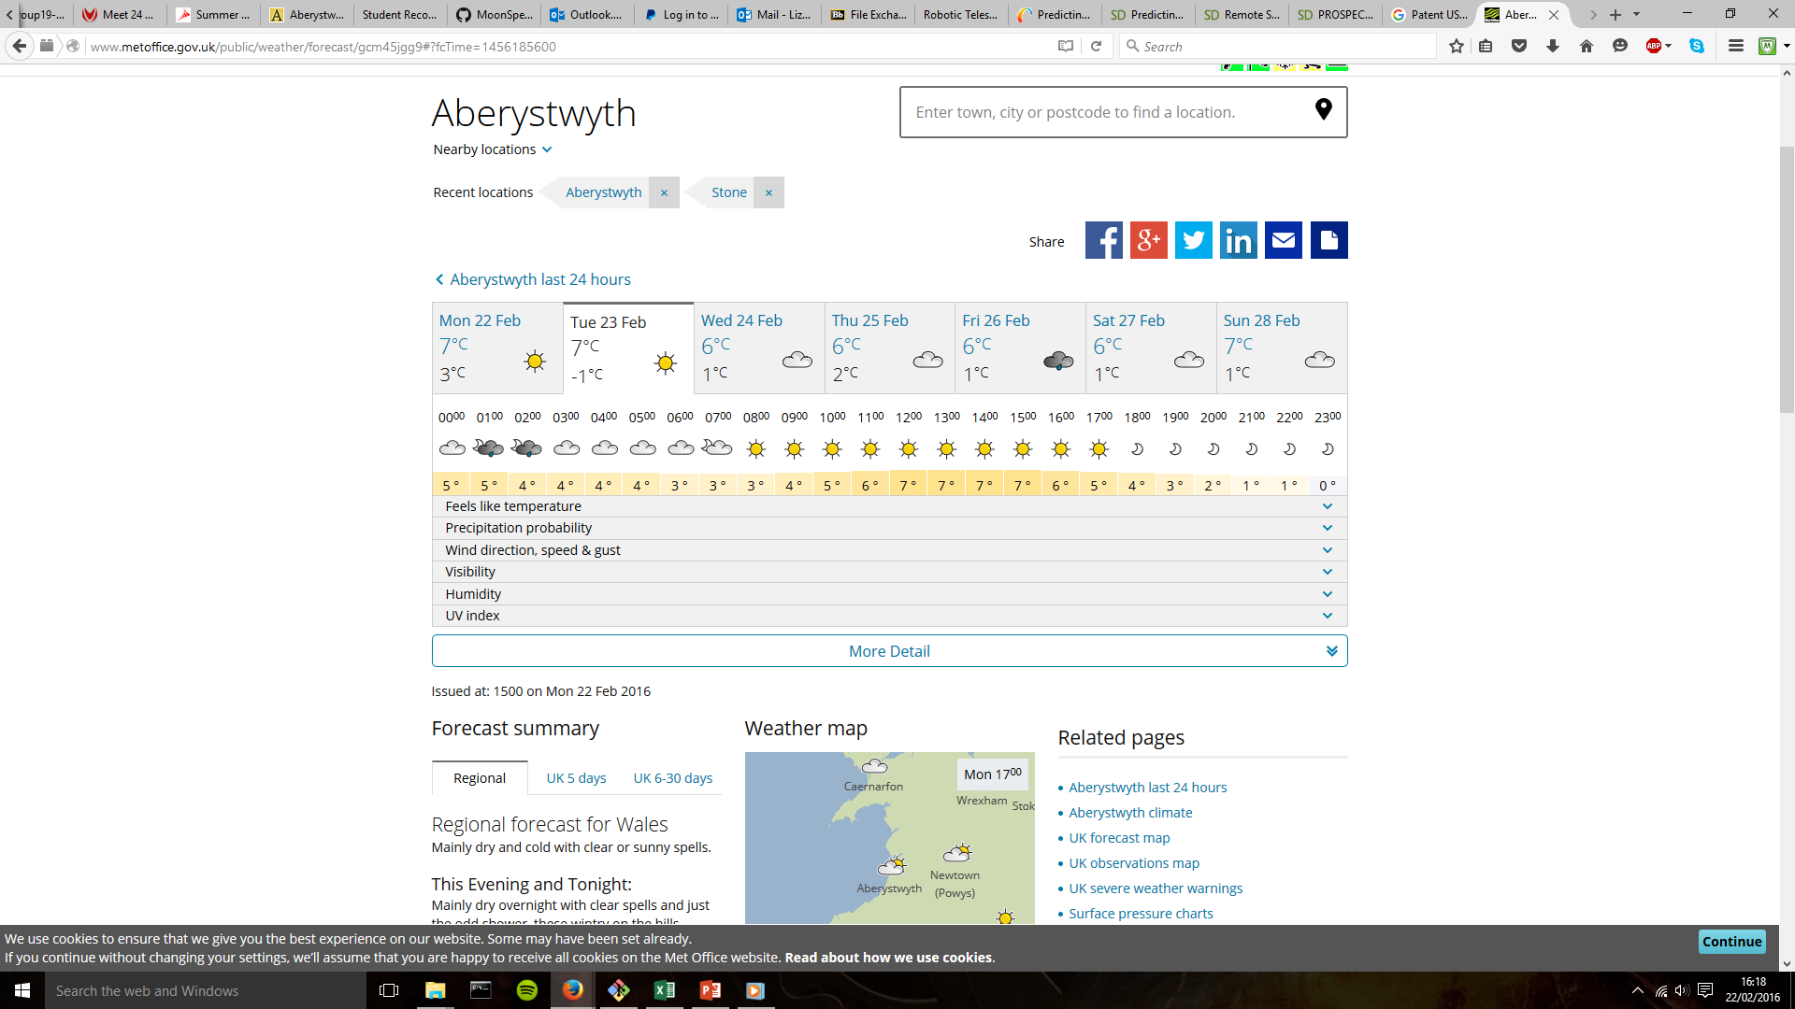
Planning with the weather and lunar-tables
http://www.metoffice.gov.uk/public/weather/forecast/gcm45jgg9#?fcTime=1456185600
http://www.moonconnection.com/moon_phases_calendar.phtml

Slide 8
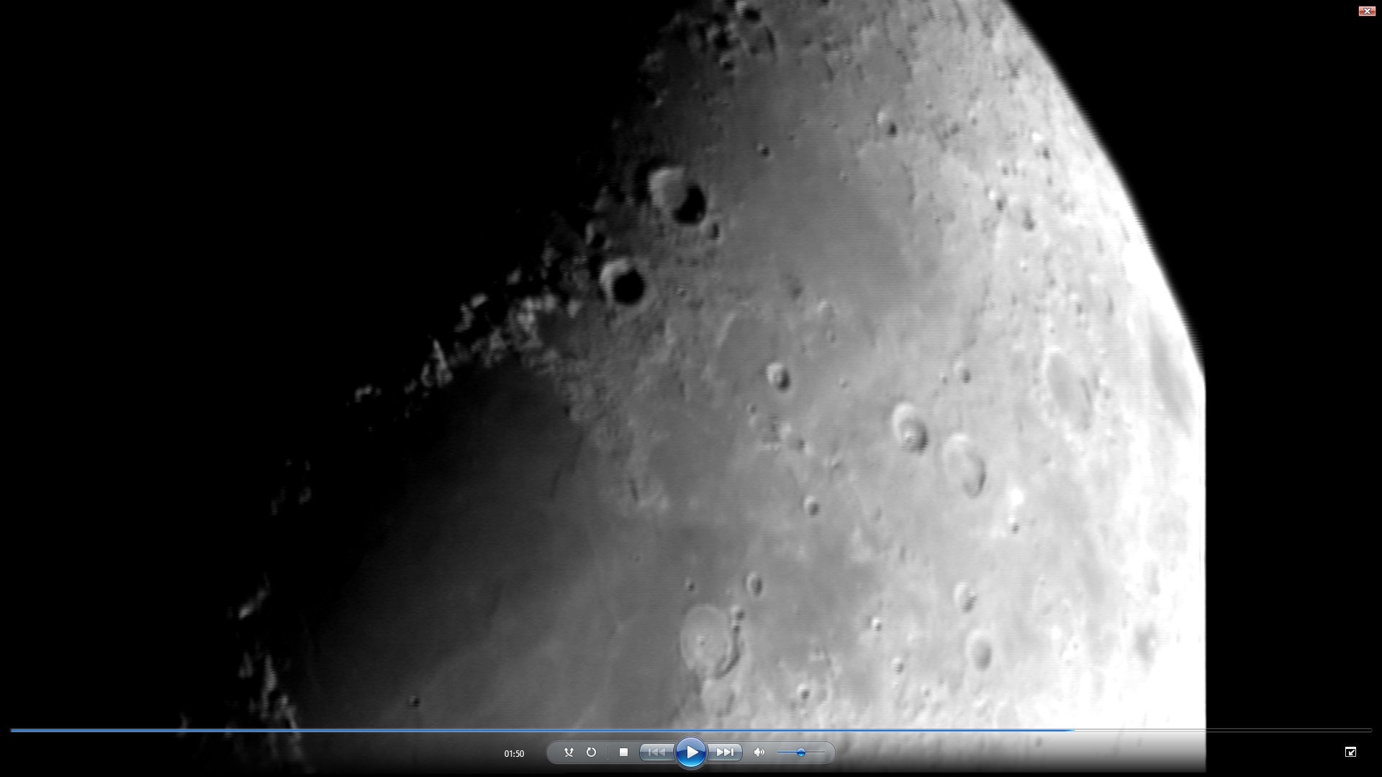
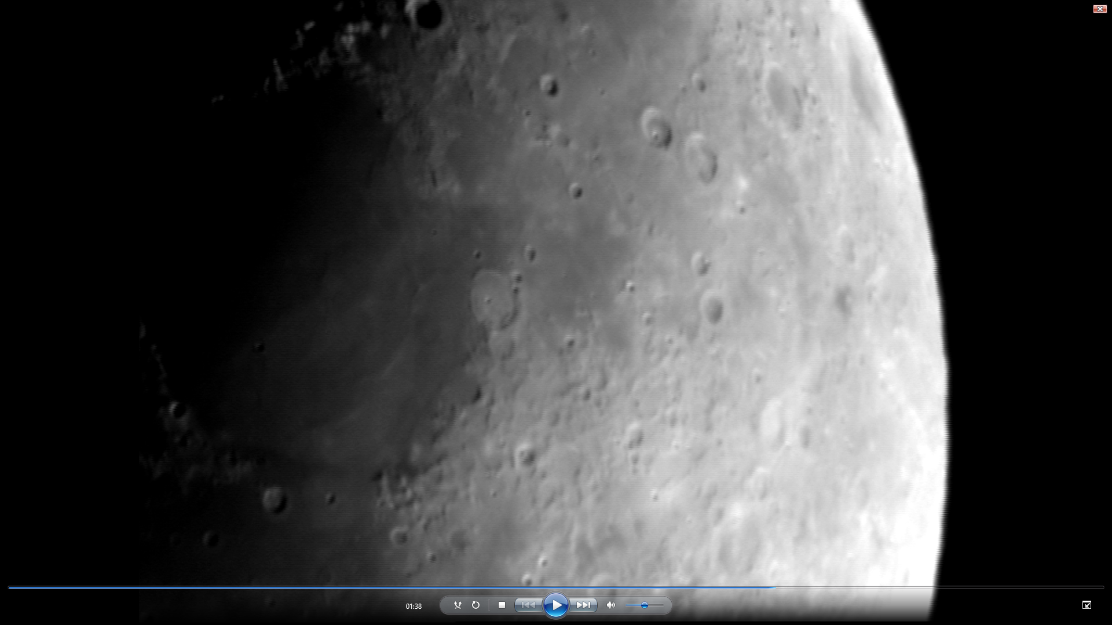
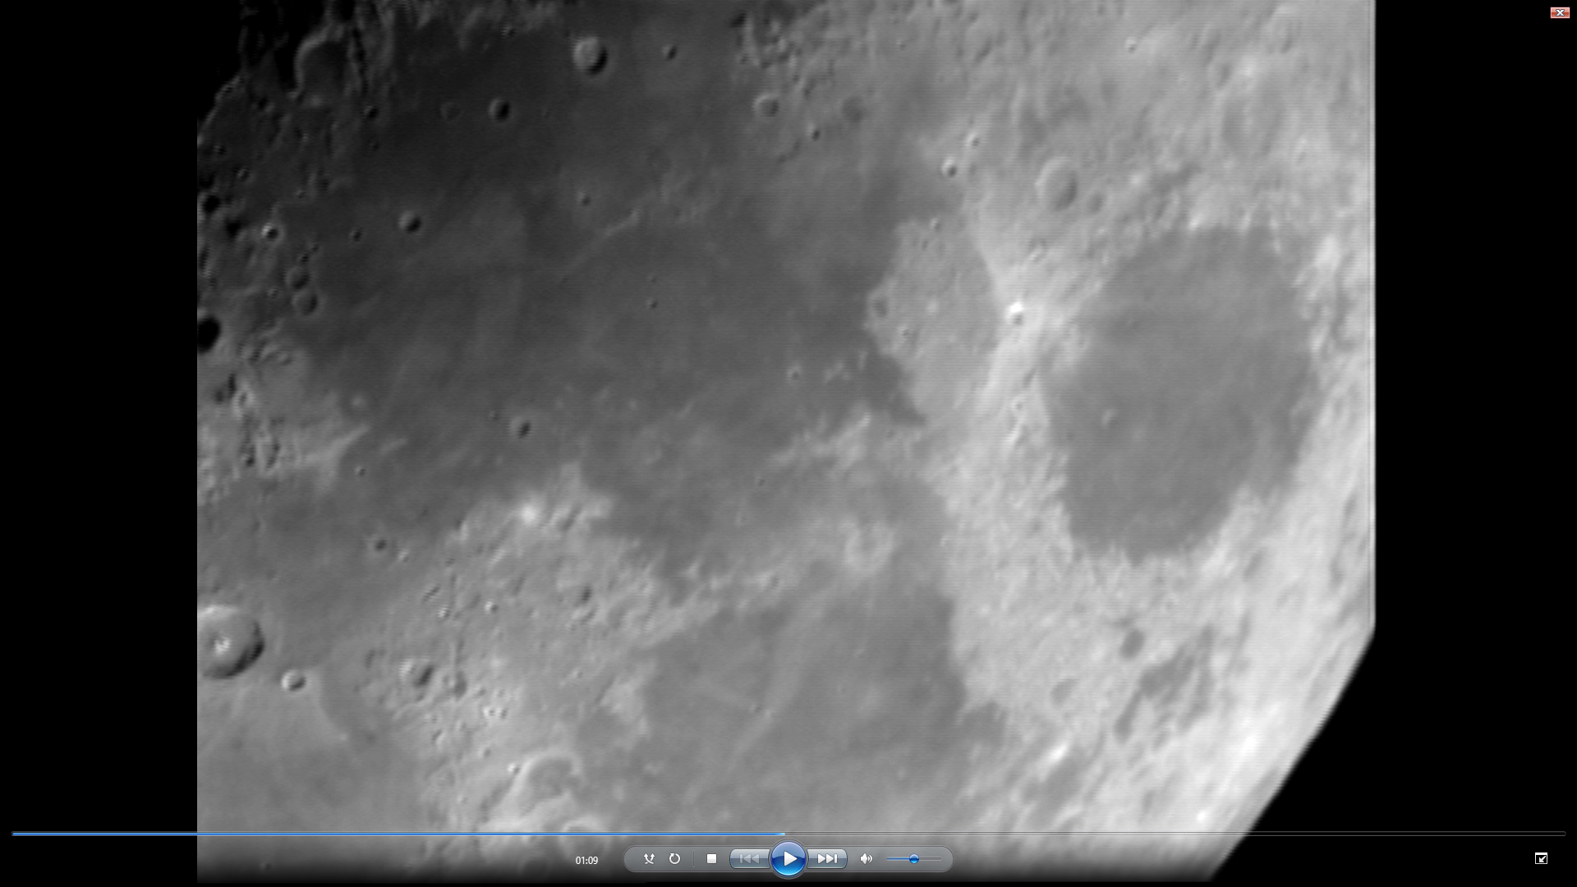
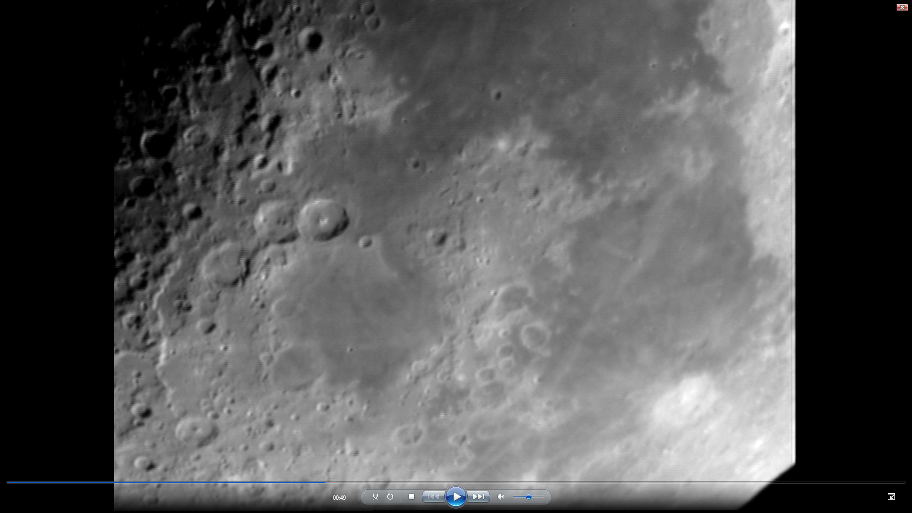
Taking our own images

Slide 9
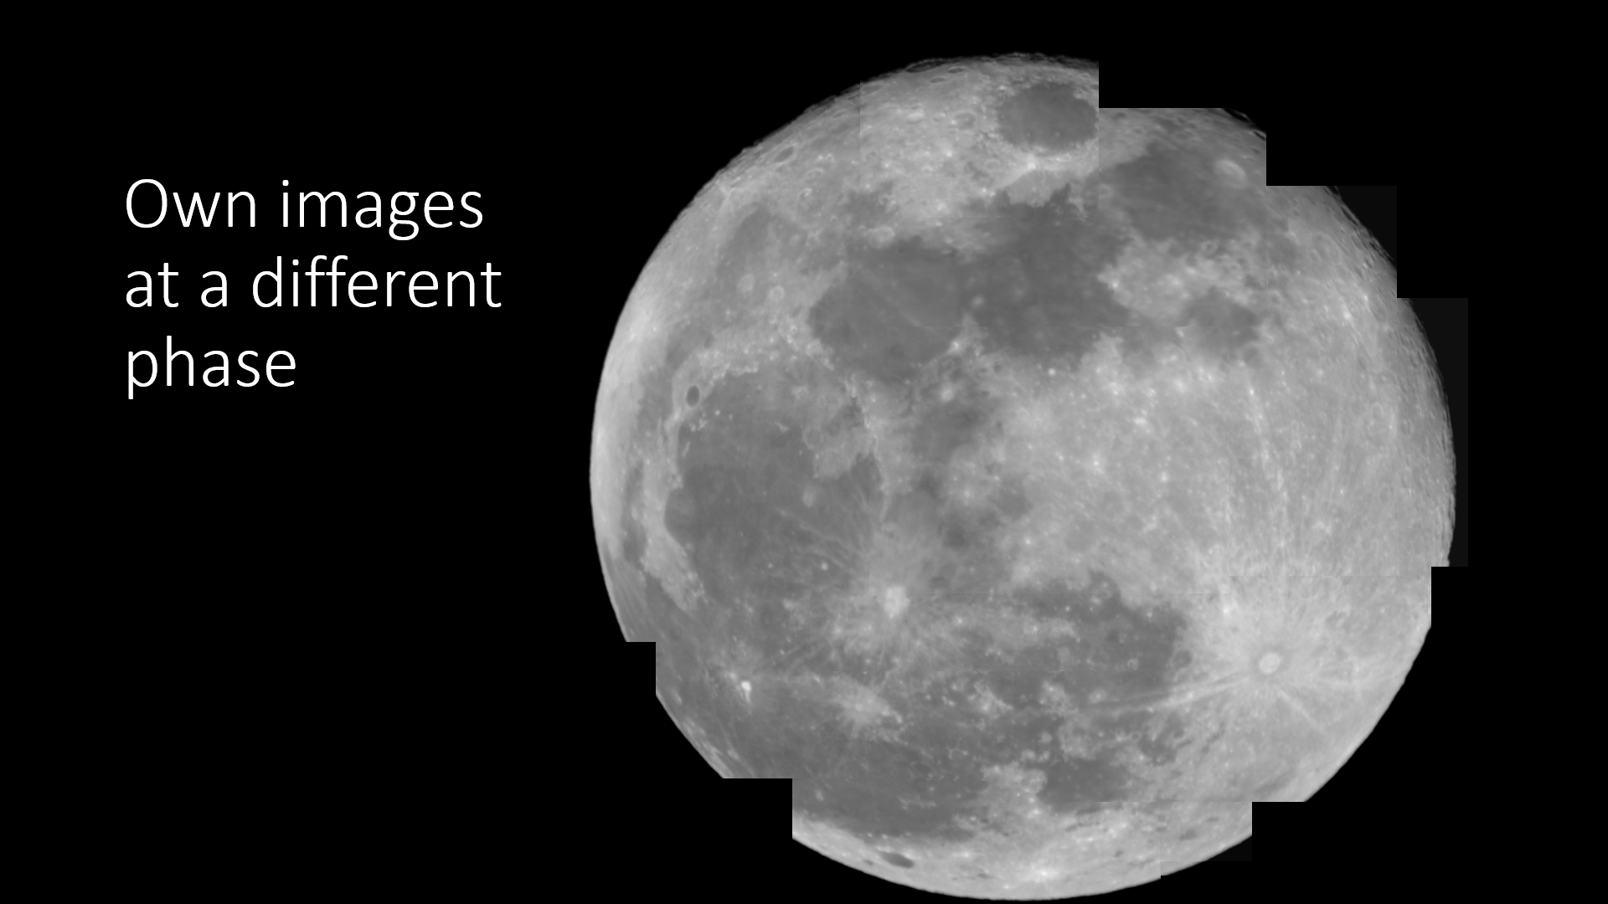

Slide 10
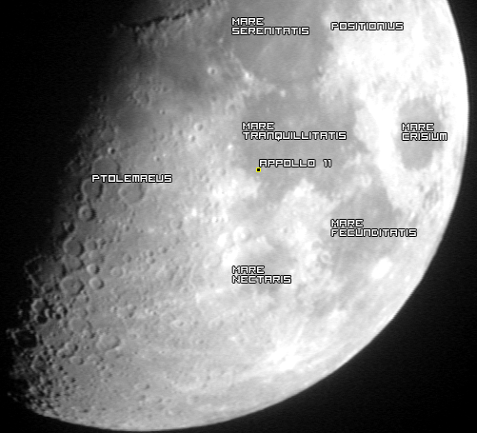
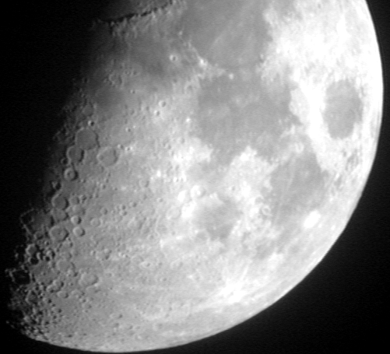
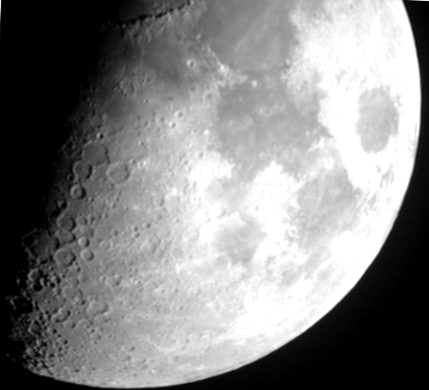
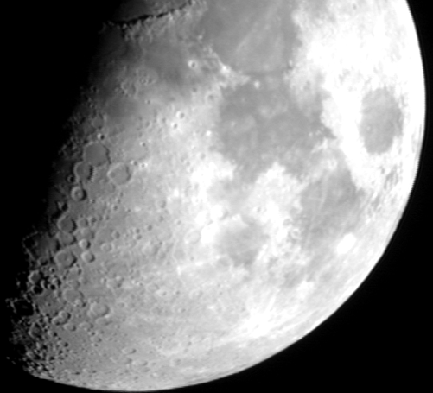
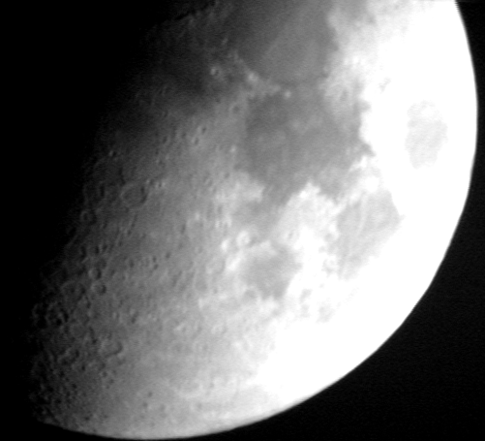
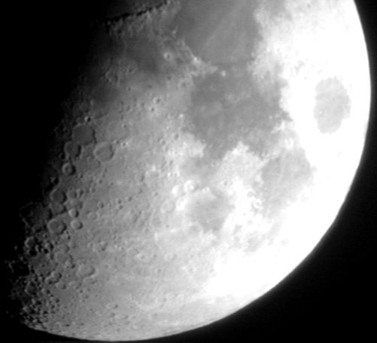
Tony’s Images (2013)
436nm
656nm
730nm
855nm
589nm

Slide 11
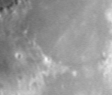
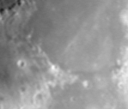
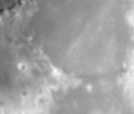
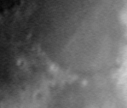
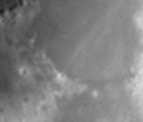
Using Tony’s Images
436nm
589nm
656nm
730nm
855nm
Only use small area of these images where they aren’t saturated or suffering from other effects (Tom, any other reason?)
R-Band of Mare Serenitatis, top center of image, and Mare Tranquillitatis, right.

Slide 12
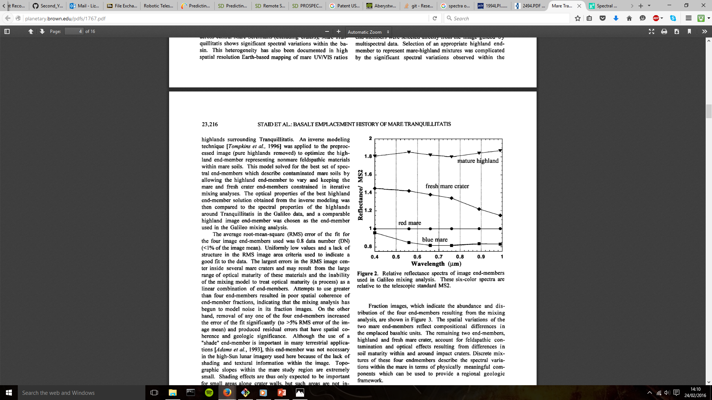
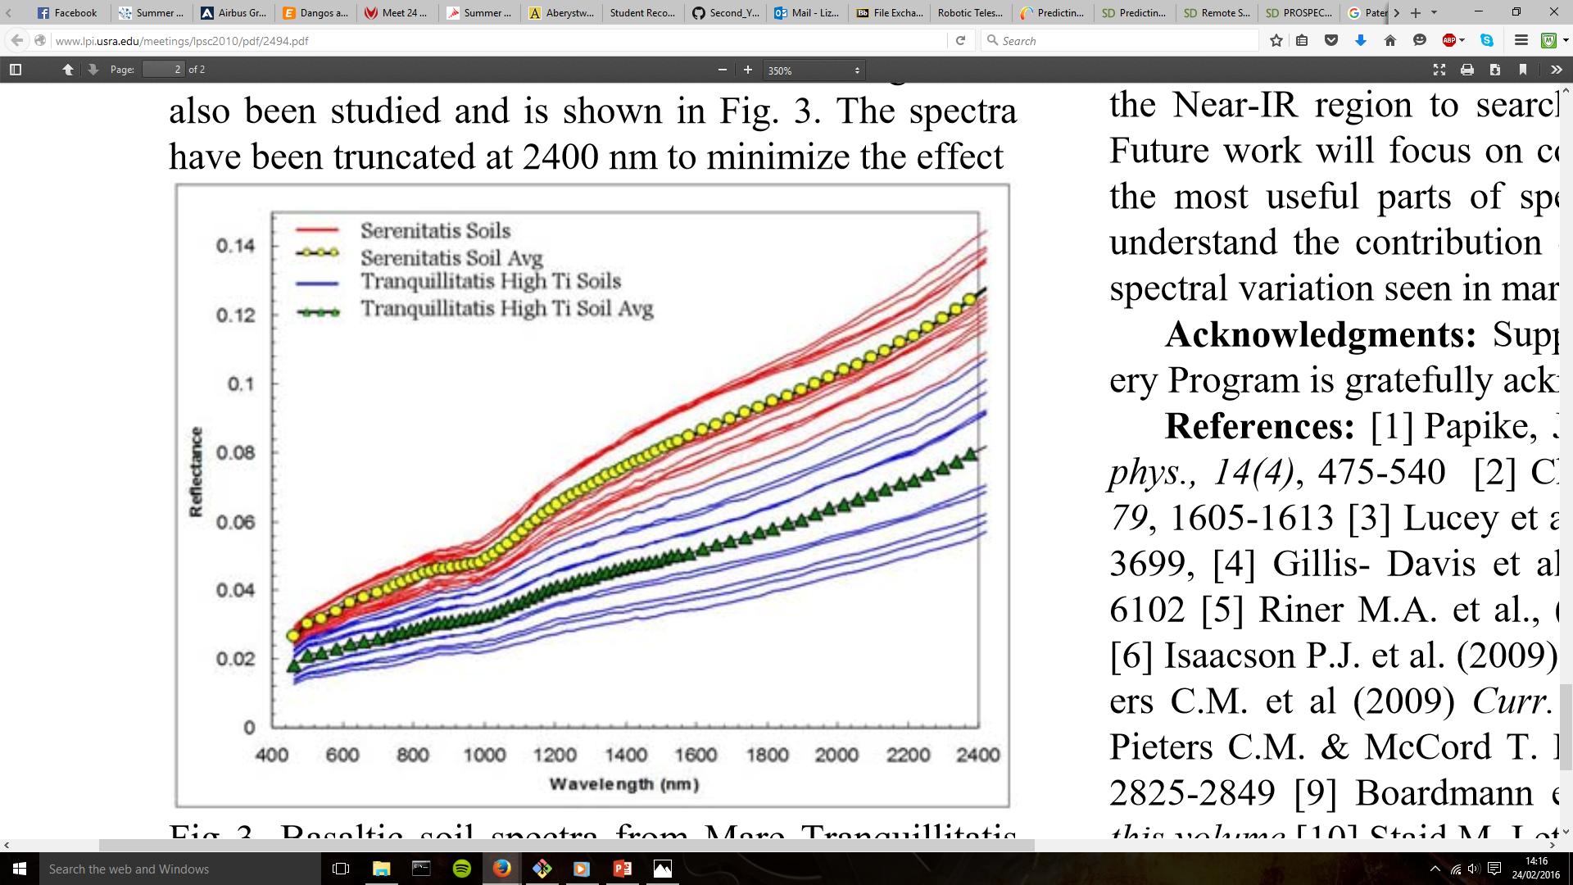
Comparing to known spectra for calibration
JOURNAL OF GEOPHYSICAL RESEARCH, VOL. 101, NO. El0, PAGES 23,213-23,228, OCTOBER 25, 1996
Mare
Tranquillitatis
Mare
Serenitatis
41stLunarandPlanetaryScienceConference(2010), http://www.lpi.usra.edu/meetings/lpsc2010/pdf/2494.pdf

Slide 13
False Colour Imaging
Combined the images to create RGB image where:
Red represents I-band,
Green representing R-band
Blue representing B-band
Other bands were too blurry or were saturated

Slide 14
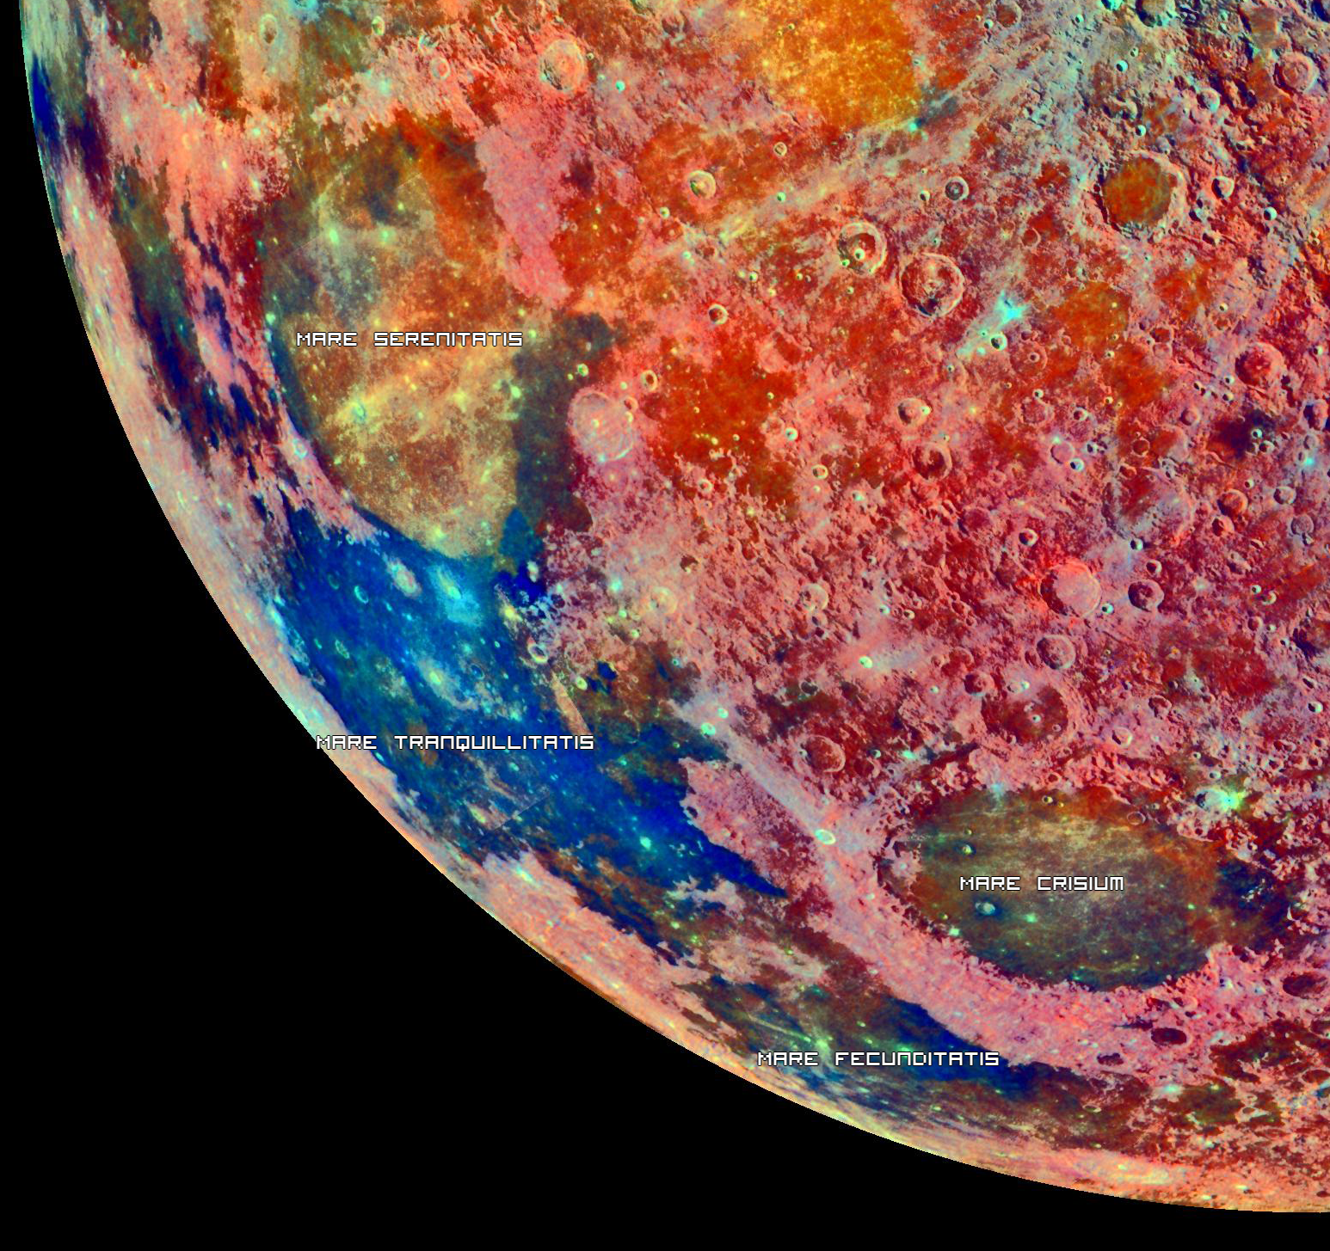
Comparing this to NASAs spectral composition of the moon shows a similar result where Mare Serenitatis is in the green-yellow part of the spectrum and Mare Tranquillitatis is in the blue-purple part.

Slide 16
Comparing Different mare and highland

Slide 18
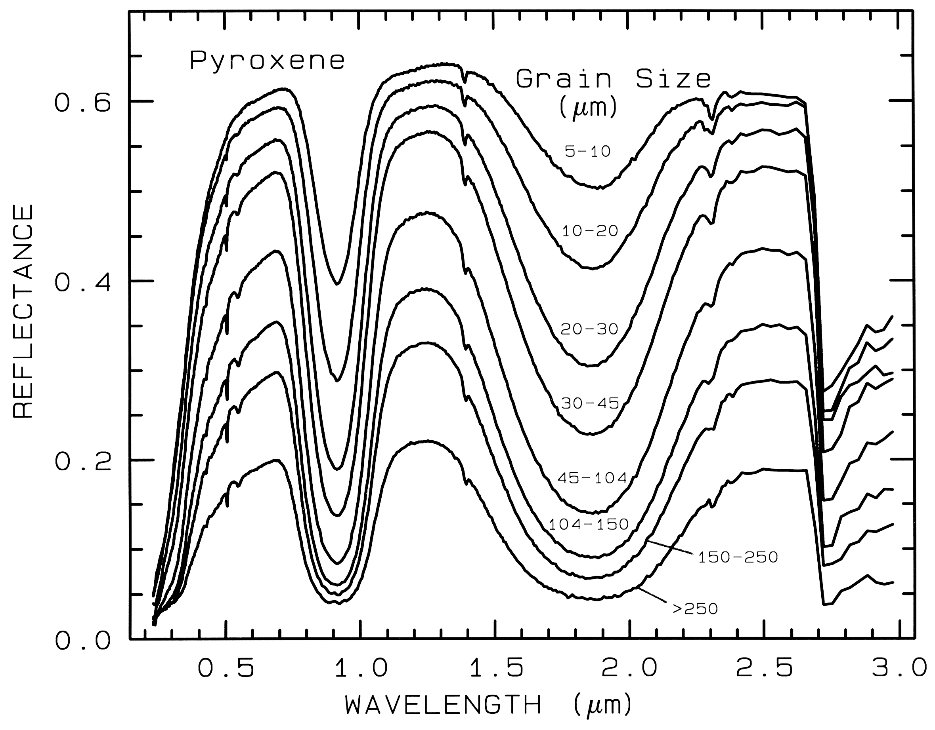
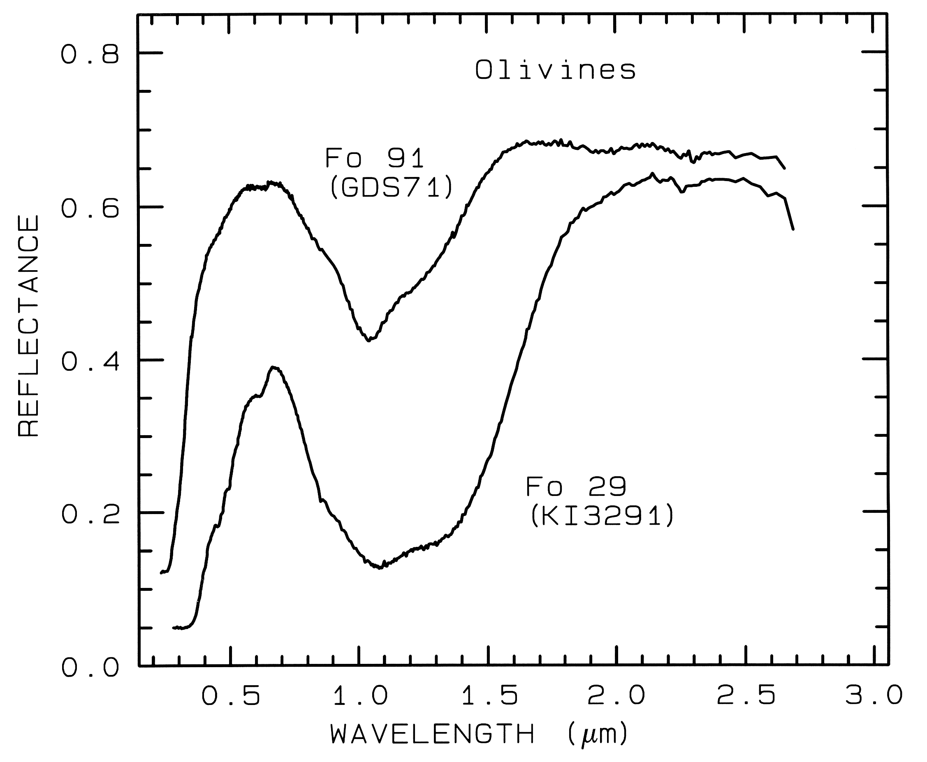
Finding Mineral Absorption Bands
http://speclab.cr.usgs.gov/PAPERS.refl-mrs/refl4.html

Slide 19
Finding Mineral Absorption Bands
Mare
Tranquillitatis
Mare
Serenitatis
Both contain pyroxene (though can’t determine grain size)
Mare Serenitatis probably contains Fo 29
http://speclab.cr.usgs.gov/PAPERS.refl-mrs/refl4.html

Slide 20
How accurately can we measure the absorption bands in the spectra?
Depends on calibration of scope, therefore very hard to determine.
By taking into account the following affects we can reduce errors

Slide 21
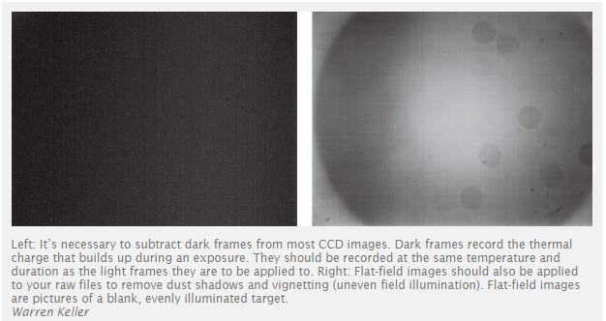
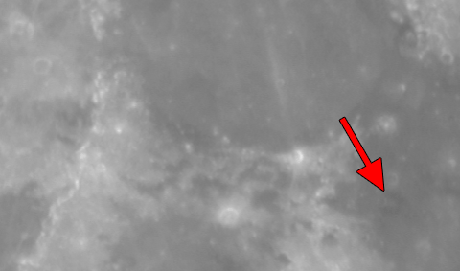
Optical effects:
Vignetting:
Effect that darkens the corners of a picture
Flat-field images is a technice to reduce vignetting
Also removes any dust rings

Slide 22
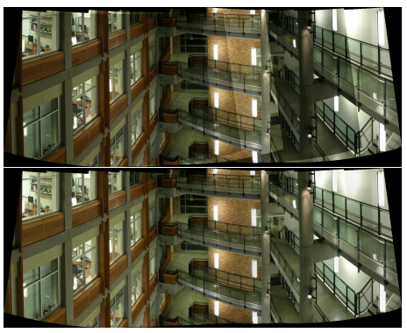
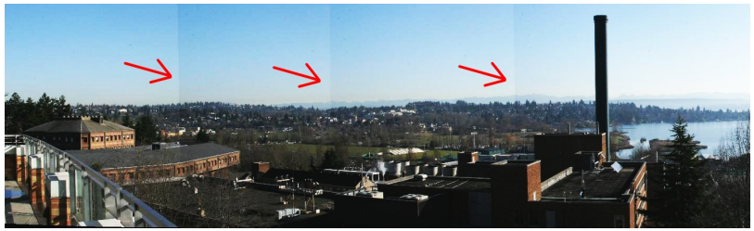
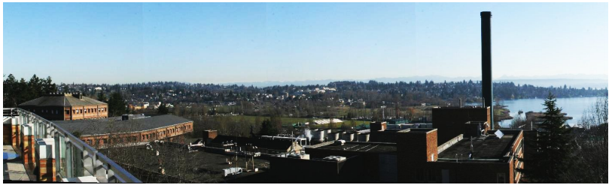
Vignetting Examples:

Slide 23
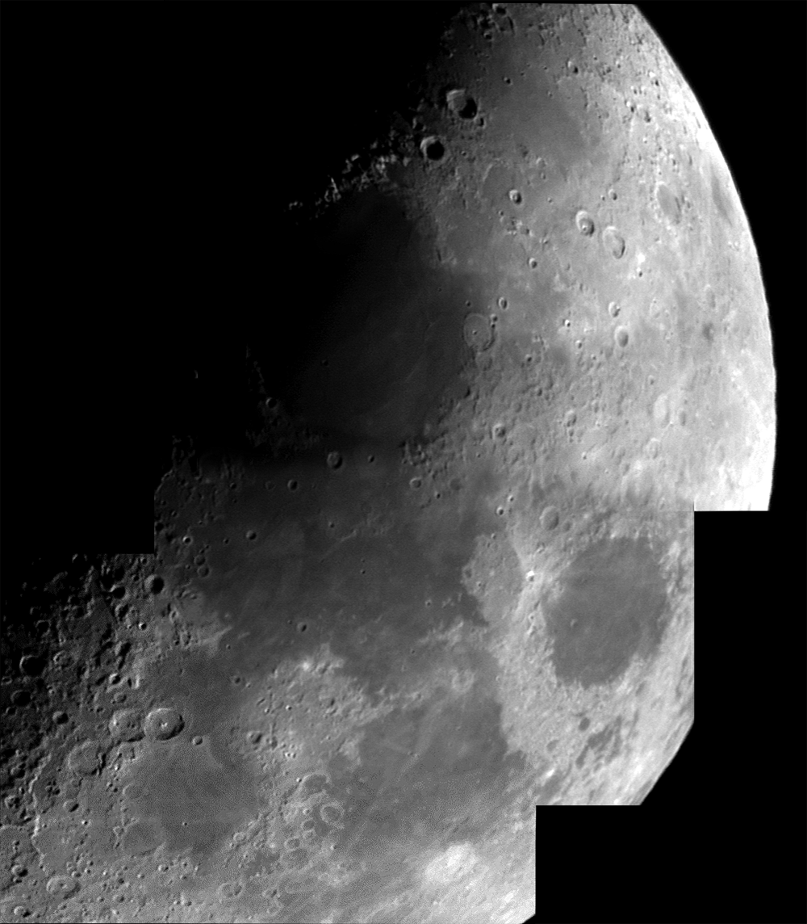
Correcting images

Slide 24
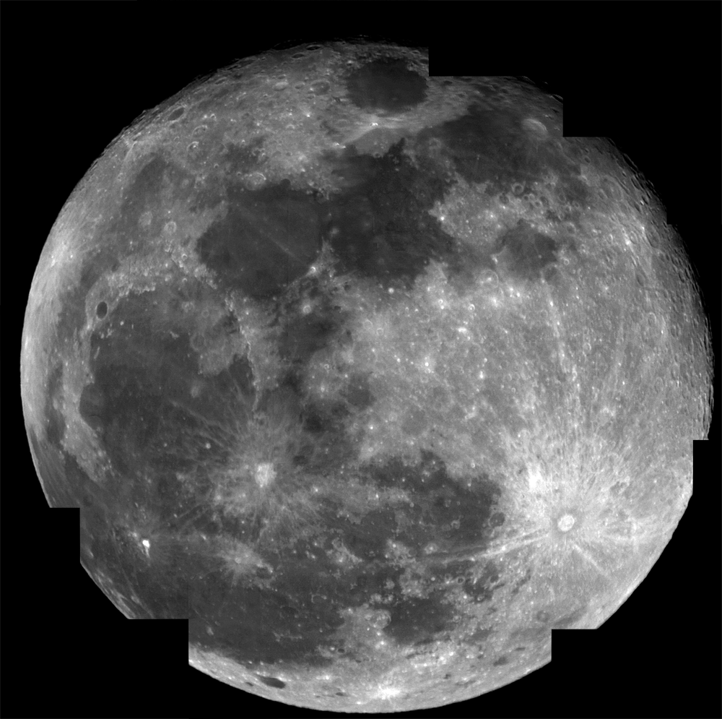
No vignetting and much sharper

Slide 25
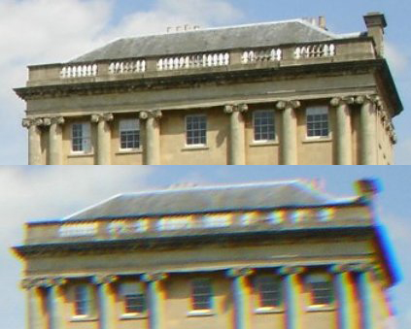
Chromatic aberration
Happens in poorly made lenses
Different reflective indices
Seen in strong contrast
Effects are probably negligable in this experiment
https://en.wikipedia.org/wiki/Chromatic_aberration

Slide 26

Clouds/Atmospheric Effects
In the first set of our images, can see the effects of clouds (the darker patch)
Even without clouds our atmosphere will affect our images

Slide 27
Other effects
(Tom’s pictures and graphs that take into account earth’s atmosphere, as it will effect absorption bands)
Light pollution also needs to be taken into account(clearer sky)

